Slide 1
Mobile programming
Lecture 3

Slide 2
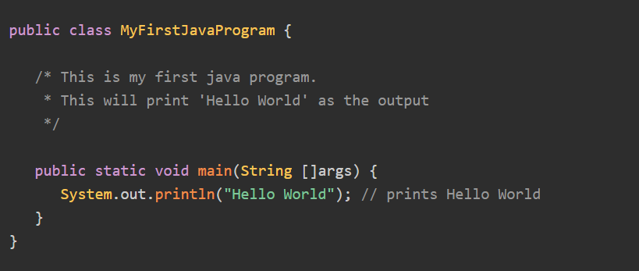
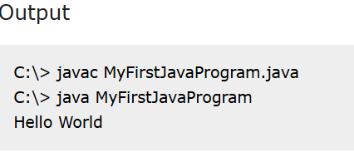
Java - Hello World Program
Type the code and see the result!

Slide 3
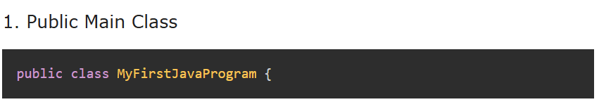
Explanation of Hello World Program
As we've successfully printed Hello World on the output screen. Let's understand the code line by line.
Note: Its recommend to make the name of file same with name of your class!
This line is creating a new class MyFirstJavaProgram and being public, this class is to be defined in the same name file as MyFirstJavaProgram.java.
public − defines the scope of the main method. Being public, this method can be called by external program like JVM, which means all users have the access to this file!

Slide 4
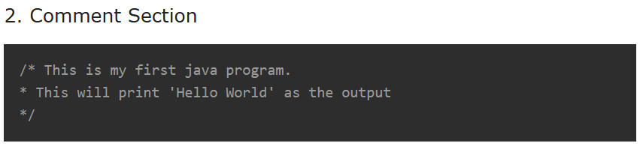
If you want to comment long text use /* * */
//

Slide 5
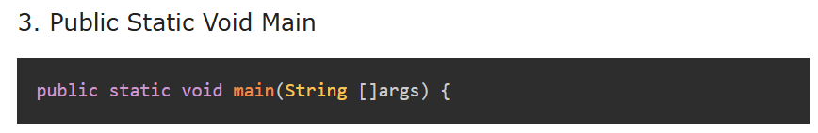
static − defines the state of the main method. Being static, this method can be called by external program like JVM without first creating the object of the class.
void − defines the return type of the main method. It is function like in python ‘def’.
main − name of the method
String []args − arguments passed on command line while executing the java command.

Slide 6
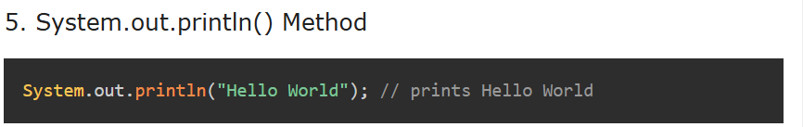
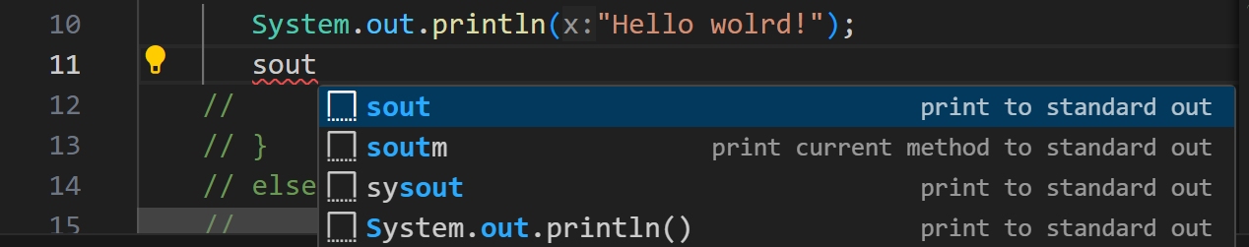
System.out represents the primary console and its println() method is taking "Hello World" as input and it prints the same to the console output.
write ‘sout’ and press ‘Enter’. Now try it!

Slide 7
Exercise number 1!
Task: Instead of “Hello world!” you need to type text “ My name is (type your name) and coding in Java is fun!”

Slide 8
Exercise number 2!
Task: Comment as we’ve learned how to make comment you need to write both types of the commnt for long comment and line comment. For long comment type this text:
The name "Java" was inspired by coffee! The developers originally called it "Oak," but since that name was already taken, they renamed it after Java coffee, a type of coffee from Indonesia. That's why the Java logo features a steaming coffee cup!
For short comment type the text:
I am learning Java and it is fun !

Slide 9
Main mistakes:

Slide 10

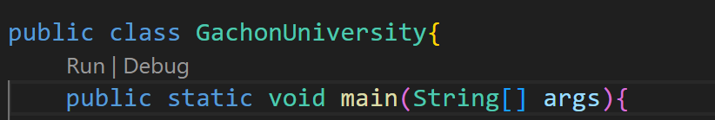

Main mistakes:

Slide 11
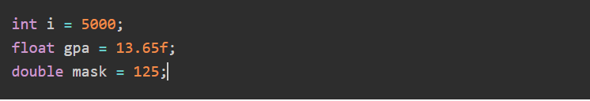
Java - Numbers Class
Normally, when we work with Numbers, we use primitive data types such as byte, int, long, double, etc.
Consider the below example:

Slide 12
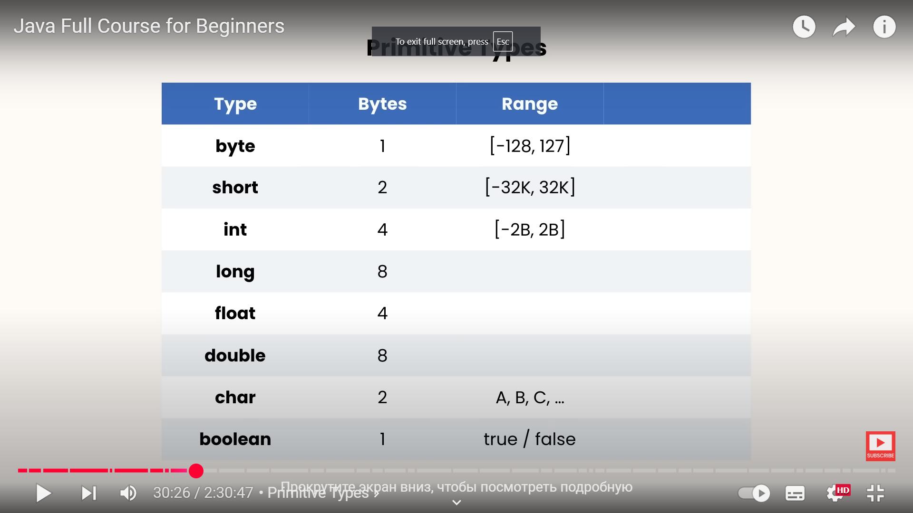


Java - Numbers Class
8-bit ${[(−2}^{7}) , {(2}^{7}−1)]$
16-bit ${[(−2}^{15}) , {(2}^{15}−1)]$
32-bit ${[(−2}^{31}) , {(2}^{31}−1)]$
-9 223 372 036 854 775 … 9 223 372 036 854 775 807
64-bit ${[(−2}^{63}) , {(2}^{63}−1)]$
-3.4 *1038 … 3.4 * 1038
32-bit IEEE 754 floating-point
±4.9 * 10-324 … ±1.79769313483157 * 10308
64-bit IEEE 754 floating-point default data type
for decimal values
16-bit Unicode character

Slide 13
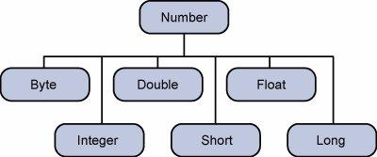

It is the superclass of the classes that represent numeric values convertible to primitive data types such as byte, short, int, long, float, and double

Slide 14
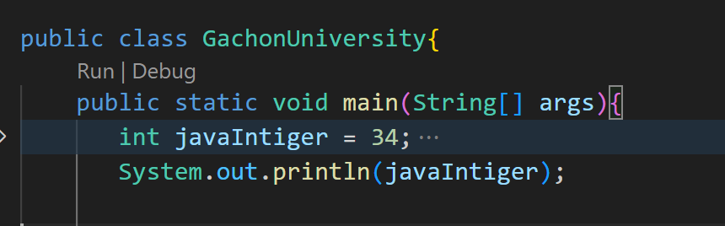

Intigers

Slide 15
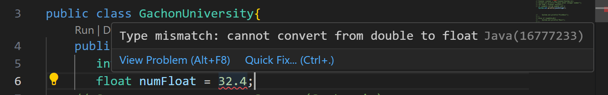
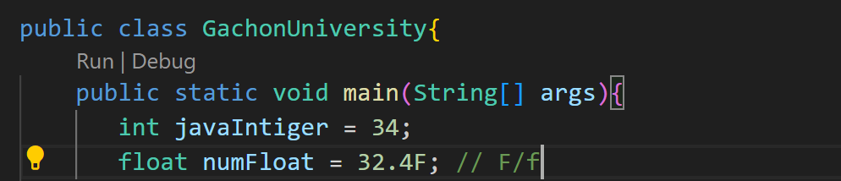
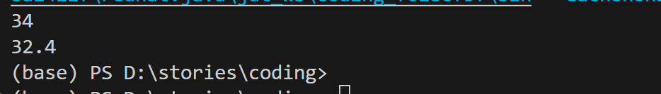
why here rises mistake?

Slide 16
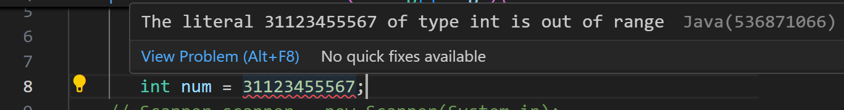
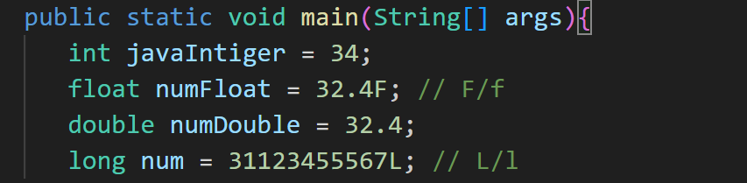

Slide 17
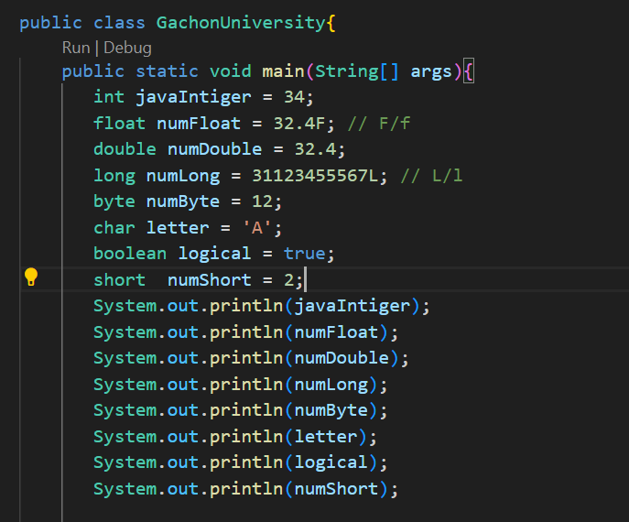
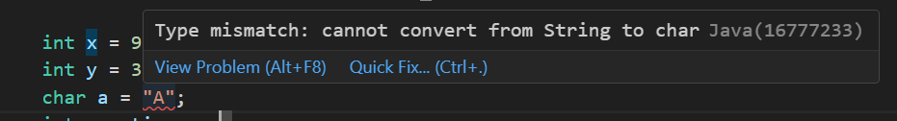
for char we cant use (“”)
only single (‘’)
because double we use for string
regarding to python in java String is lis like library

Slide 18
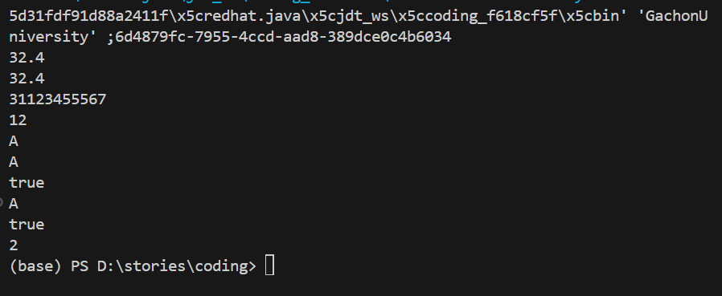

Slide 19
Exercise !
Table 1
Task: Write the code which will execute all the types which shown in the table 1.

Slide 20
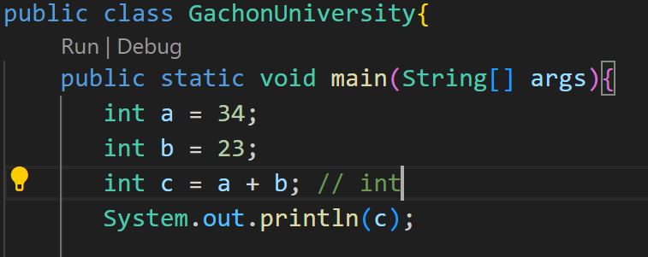
Exercise !
Task: You are given list of equations you need to solve them looking at the given example:
addition:
a = 23
b = 12
c = a + b;
subtraction:
g = 26
u = 19
d = g - u;
multiplication:
l = 2
k = 19
q = l*k;
devision:
w = 6
d = 2
i = w/d

Slide 21
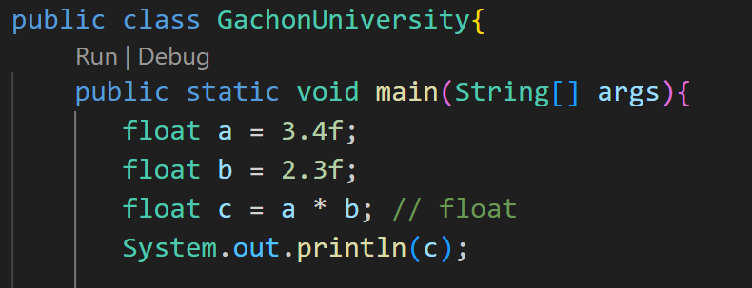
Exercise !
Task: You are given list of equations you need to solve them looking at the given example:
addition:
a = 56.2
b = 12.8
c = a + b;
subtraction:
g = 12.4
u = 1.8
d = g - u;
multiplication:
l = 2.2
k = 1.9
q = l*k;
devision:
w = 6.2
d = 2.1
i = w/d

Slide 22
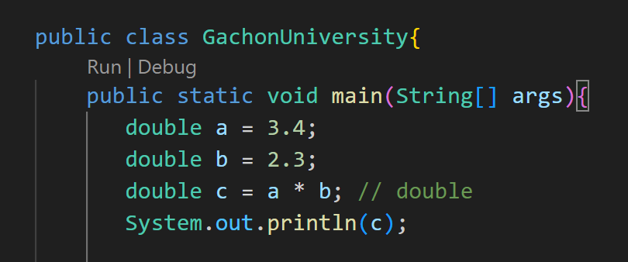
Exercise !
Task: You are given list of equations you need to solve them looking at the given example:
addition:
a = 56.2
b = 12.8
c = a + b;
subtraction:
g = 12.4
u = 1.8
d = g - u;
multiplication:
l = 2.2
k = 1.9
q = l*k;
devision:
w = 6.2
d = 2.1
i = w/d
execute the code and see the results between float and double

Slide 23
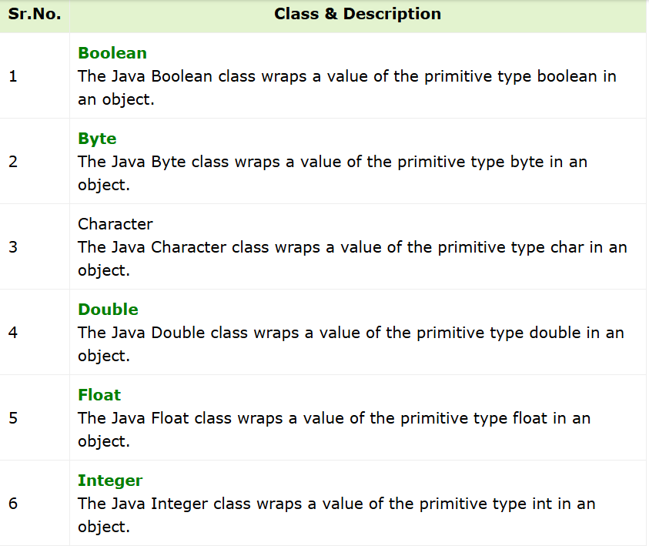
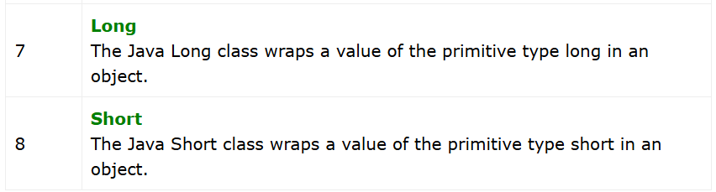

Slide 24
Java Type Casting (Conversion)
Type casting
is a technique that is used either by the compiler or a programmer to convert one data type to another in Java. Type casting is also known as type conversion. For example, converting int to double, double to int, short to int, etc.
There are two types of type casting allowed in Java programming:
Widening type casting
Narrowing type casting

Slide 25
Widening Type Casting
Widening type casting is also known as implicit type casting in which a smaller type is converted into a larger type, it is done by the compiler automatically.
1. Hierarchy
Here is the hierarchy of widening type casting in Java:
The compiler plays a role in the type conversion instead of programmers. It changes the type of the variables at the compile time. Also, type conversion occurs from the small data type to large data type only.

Slide 26
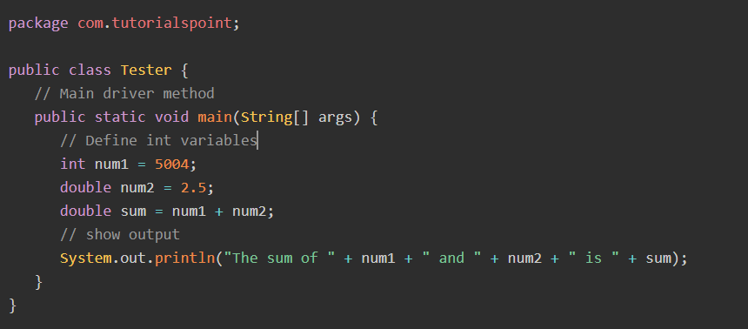
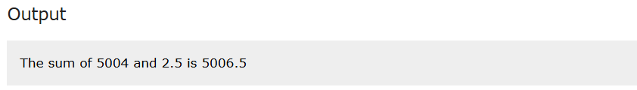
example:
Why double ?

Slide 27
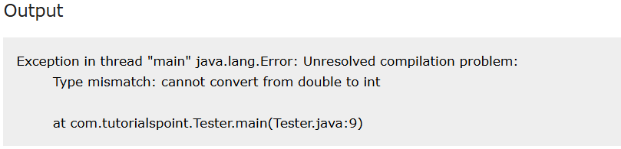
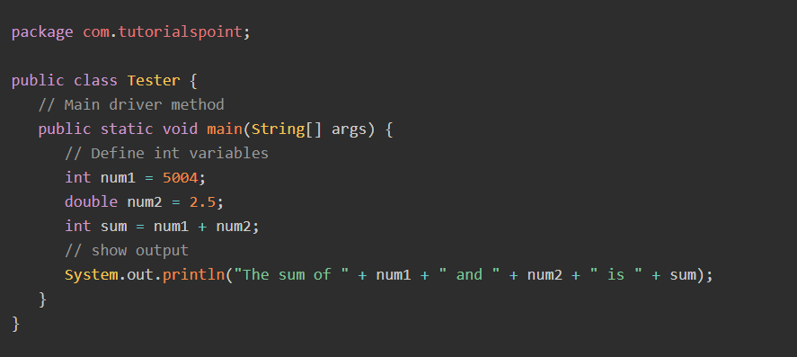
In the example below, we demonstrated that we can get an error when the compiler tries to convert a large data type to a small data type. Here, we created the num1 integer and num2 double variable. The sum of num1 and num2 will be double, and when we try to store it to the sum of the int type, the compiler gives an error.

Slide 28
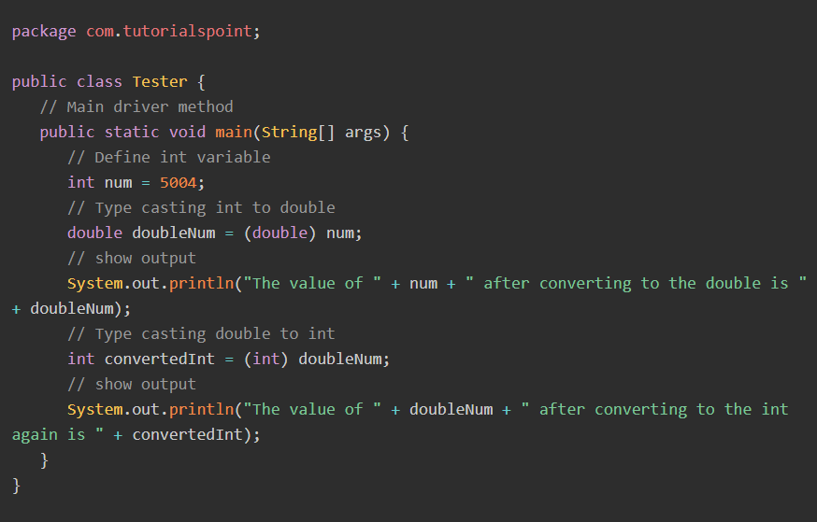
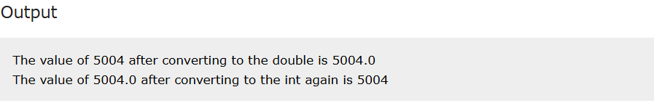

Slide 29
Task: By looking at this image of hierarchy of widening type casting, you have to solve these equations of given numbers:
byte num6 = 2;
short num3= 4;
int num5 = 23;
long num1 = 23456785343L;
float num2 = 567.4F;
double num4 = 12.5;
___ sum1 = num1 + num2;
____sum2 = num2 + num3;
____sum3 = num3 + num4;
____sum4 = num4 + num5;
____sum5 = num5 + num6;
____sum6 = num6 + num1;

Slide 30
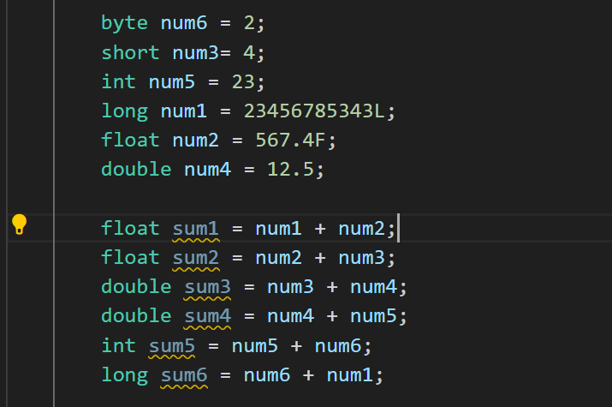

Slide 31
Thanks for your attention

